Slide 1


Slide 2
Report On
Walton Hi-Tech Industries PLC
Prepared By
Madhabi Biswas
Batch:50

Slide 3
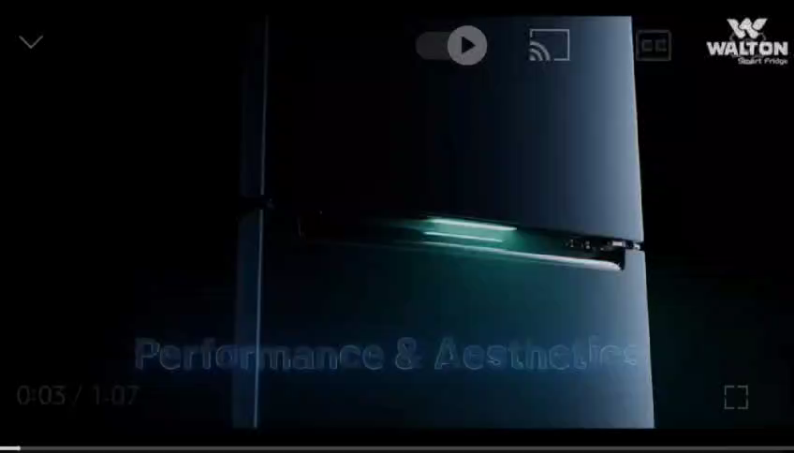

Slide 4
Company Profile
Walton: A Global Leader in Electrical, Electronics & Appliances Manufacturing
Headquarters: Bangladesh
Workforce: 30,000+ employees
Production Facilities: 22 bases across 700+ acres
Annual Production Capacity: 10 million units
Industries: Electrical, Electronics, Automobiles, Appliances
Global Recognition: Renowned for quality, cost-efficiency, design, and innovation
R&D Leadership: One of the largest research and innovation facilities worldwide

Slide 5
Product & Services
Products
Consumer Electronics
Home Appliance
Kitchen Appliances

Slide 6
Consumer Electronics
Television
Mobile Phone
Laptop

Slide 7
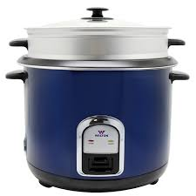
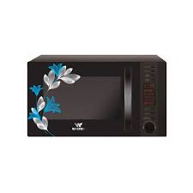
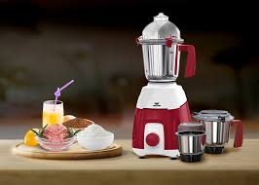
Kitchen Appliances
Rice Cooker
Microwave
Blenders and Grinders

Slide 8
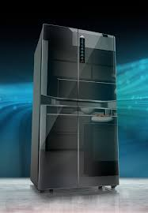
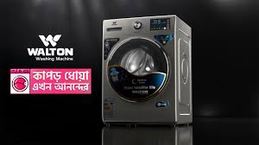
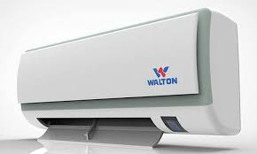
Home Appliance
Refrigerators and Freezers
Air Conditioners
Washing Machines

Slide 9
Product & Services
Services
Warranty Services
Customer Support
Installation Services
After-Sales Service
Spare Parts Availability

Slide 10
Business Plan
Operational Plan
Financial Plan
Marketing Plan

Slide 11
SWOT Analysis of Walton BD
SWOT
Strengths
Dominance in the local market.
Cost advantages due to local production.
Wide range of products.
Weaknesses
Heavy reliance on the Bangladeshi market.
Challenges in competing with global brands in international markets.
Opportunities
Expansion into new markets (e.g., Africa, Middle East).
Growth in the electric vehicle segment.
Investment in renewable energy products.
Threats
Economic instability in target export markets.
Increased competition from international brands.

Slide 12
Sales and Cost statistics
Total Sales by Region
Region | Sum of Total Sales (BDT)
Barishal | 5010000
Chittagong | 4340000
Dhaka | 5850000
Khulna | 4110000
Rajshahi | 4760000
Sylhet | 4600000
Grand Total | 28670000

Slide 13


